Slide 1
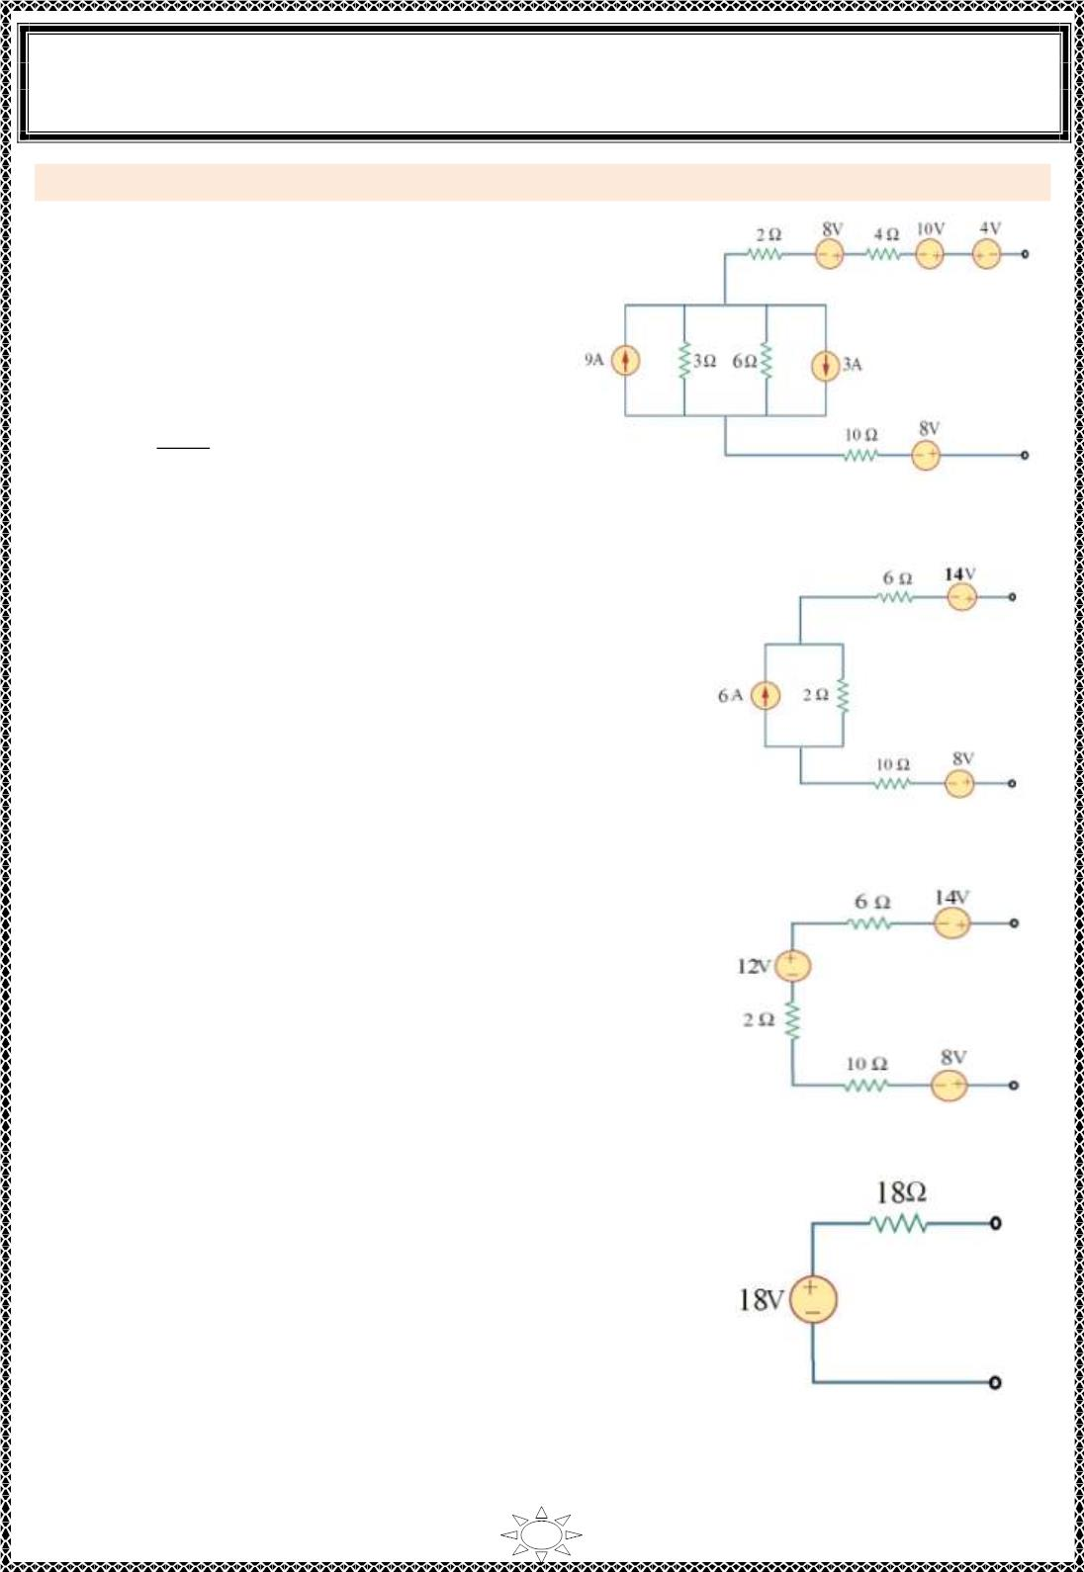
University of Diyala
Engineering College
Electronic Department
Electrical Engineering Fundamentals
1st Class
Asst., Lecturer : Wisam N. AL-Obaidi
Year (2013-2014)
Example 11: transform the network shown in Figure(2.49) to single ideal voltage sources.
Solution:
❖ The two current sources are in parallel.
Hence they have an equivalent,
I = I + I = 9 – 3 = 6 A
1
2
With two resistors in parallel. Hence the
equiva le nt resistor is,
R =
3 ×6
= 2Ω
3+6
Figure (2.49)
❖ The three vo ltage sources are in series . Hence they
have an equivalent,
V = V + V + V = 8 + 10 – 4 = 14V
1
2
3
With two resistors in series. Hence the equivalent
resistor is,
R = 2 + 4 = 6Ω
Trail Version
Trail Version
Trail Version
Trail Version
Trail Version
Trail Version
Trail Version
Trail Version
Trail Version
Trail Version
Trail Version
Trail Version
Trail Version
So the equiva lent network becomes as s hown in
Figure(2.50).
Figure (2.50)
❖ Convert the (6A) current source with (2Ω) resistor in
parallel to a voltage source with (2Ω) resistor in series
as shown in Figure(2.51).
V = IR = 6 × 2 = 12V
Fig ure (2.51)
❖ Figure(2.50) shows three voltage sources in s er ies
and three res istors in series als o. Hence they have an
equivalent,
V = V + V + V = 14 + 12 – 8 = 18V
1
2
3
R = R + R + R = 6 + 2 + 10 =18Ω
1
2
3
The equivalent network is shown in Figure(2.52).
Figure (2.52)
41

Slide 2
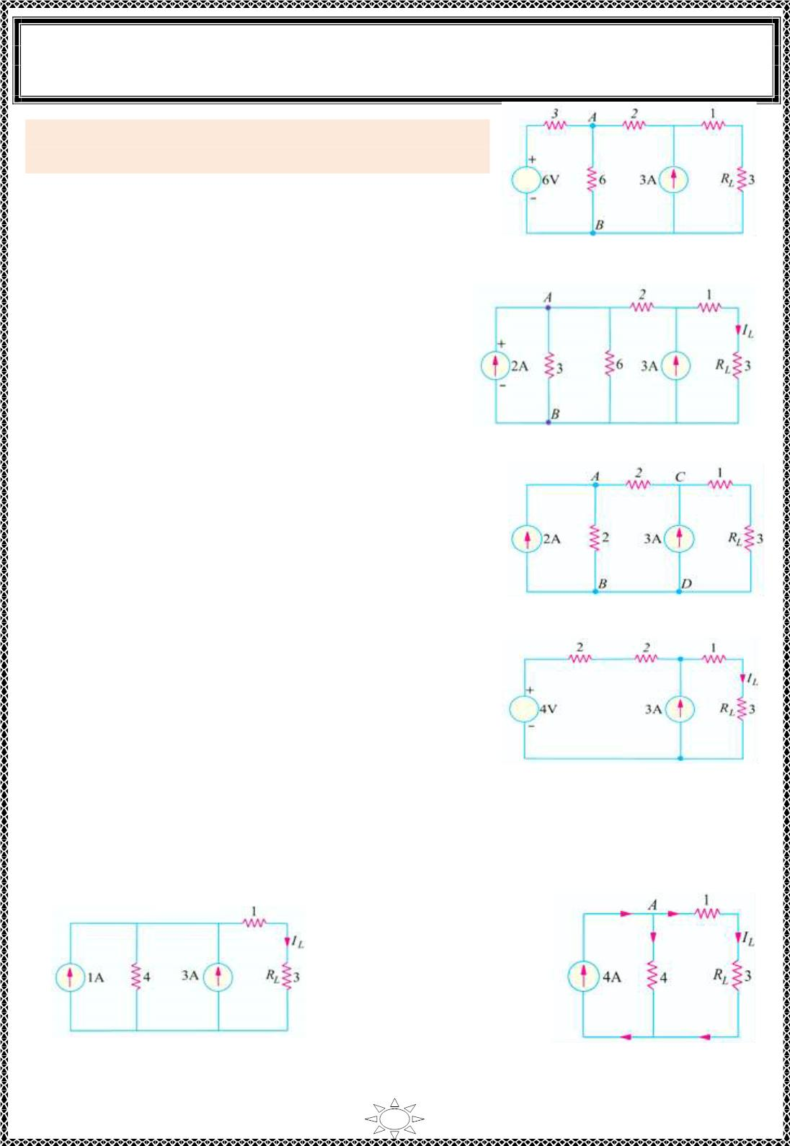
University of Diyala
Engineering College
Electronic Department
Electrical Engineering Fundamentals
1st Class
Asst., Lecturer : Wisam N. AL-Obaidi
Year (2013-2014)
Example 12: Use Source Conversion technique to find
the lo ad current I in the circuit of Figure(2.53).
Solution:
The 6V voltage source with a s er ies resistance of 3 Ω
has been converted into an equivalent 2 A current source
with 3 Ω resistance in parallel as shown in Figure(2.54).
Figure(2.53)
In Figure(2.54) the two parallel resistances of 3 Ω
and 6 Ω can be combined in to a single resistance of
2 Ω as shown in Figure(2.55).
Figure(2.54)
Figure(2.55)
In Figure(2.55) the two current sources cannot be
c ombined together because of the 2 Ω res istance present
between po ints A and C. To remove this hurd le, we
convert the 2 A current source in parallel wit h 2Ω
resistor into the equivalent 4 V vo ltage source in s er ies
with 2Ω resistor as shown in Figure(2.56).
Trail Version
Trail Version
Trail Version
Trail Version
Trail Version
Trail Version
Trail Version
Trail Version
Trail Version
Trail Version
Trail Version
Trail Version
Trail Version
In Figure(2.56) the 4 V voltage source with a s er ies
resistance of (2 + 2) = 4 Ω can again be converted into
the equivalent current source as shown in Figure(2.57).
Figure(2.56)
In Figure(2.57)the two current s ources can be combined in to a s ing le 4-A source as shown
in Figure(2.58).The 4-A current is divided into two equal parts at point A because each of
the two parallel paths has a resistance of 4 Ω. Hence I₁ = 2 A.
Figure(2.57)
Figure(2.58)
42

Slide 3
Trail Version
Trail Version
Trail Version
Trail Version
Trail Version
Trail Version
Trail Version
Trail Version
Trail Version
Trail Version
Trail Version
Trail Version
Trail Version

Slide 4
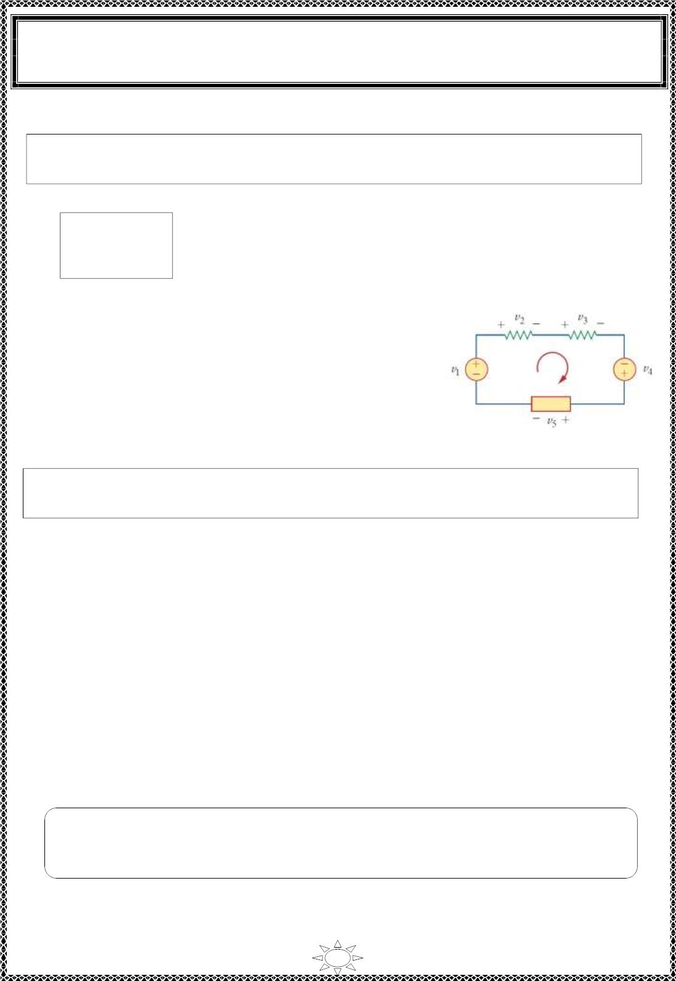
University of Diyala
Engineering College
Electronic Department
Electrical Engineering Fundamentals
1st Class
Asst., Lecturer : Wisam N. AL-Obaidi
Year (2013-2014)
2- Kirchhoff’s voltage law (KVL)
Kirchhoff’s voltage law (KVL) states that the algebraic sum of all vo ltages around
a closed path (or loop) is zero.
Expressed mathematically, KVL states that
푀
푣_{푚} = 0
Where M is the number of voltages in the loop (or the number of branches in the loop) and
v_{m} is the mth voltage.
So for Figure (3.2):
-v + v + v - v + v = 0
1
2
3
4
5
Rearranging terms gives
v + v + v = v + v
2
3
5
1
4
whic h may be interpreted as:
Fig ure (3.2)
Trail Version
Trail Version
Trail Version
Trail Version
Trail Version
Trail Version
Trail Version
Trail Version
Trail Version
Trail Version
Trail Version
Trail Version
Trail Version
Kirchhoff’s voltage law (KVL) states that the Sum of voltage drops = Sum of
voltage rises
Determination of signs for sources and elements for KVL
1- For voltage source, if we start the loop from negative terminal to positive terminal,
then the vo ltage s ho uld be given negative s ign. On other hand, If we start the lo op
from posit ive terminal to negative terminal, then the voltage s ho uld be give n
pos it ive sign.
2- For e le me nts (resistances), if we start the loop through the resistor in the same
direct ion as the current through it, then the vo ltage s ho uld be given posit ive sign.
On other hand, if we start the loop through the resistor in the opposite d irection as
the current through it, then the vo ltage s ho uld be given negative sign.
Note: you can als o reverse the two above assumption for so lv ing problems, as
stated b elo w,
44

Slide 5
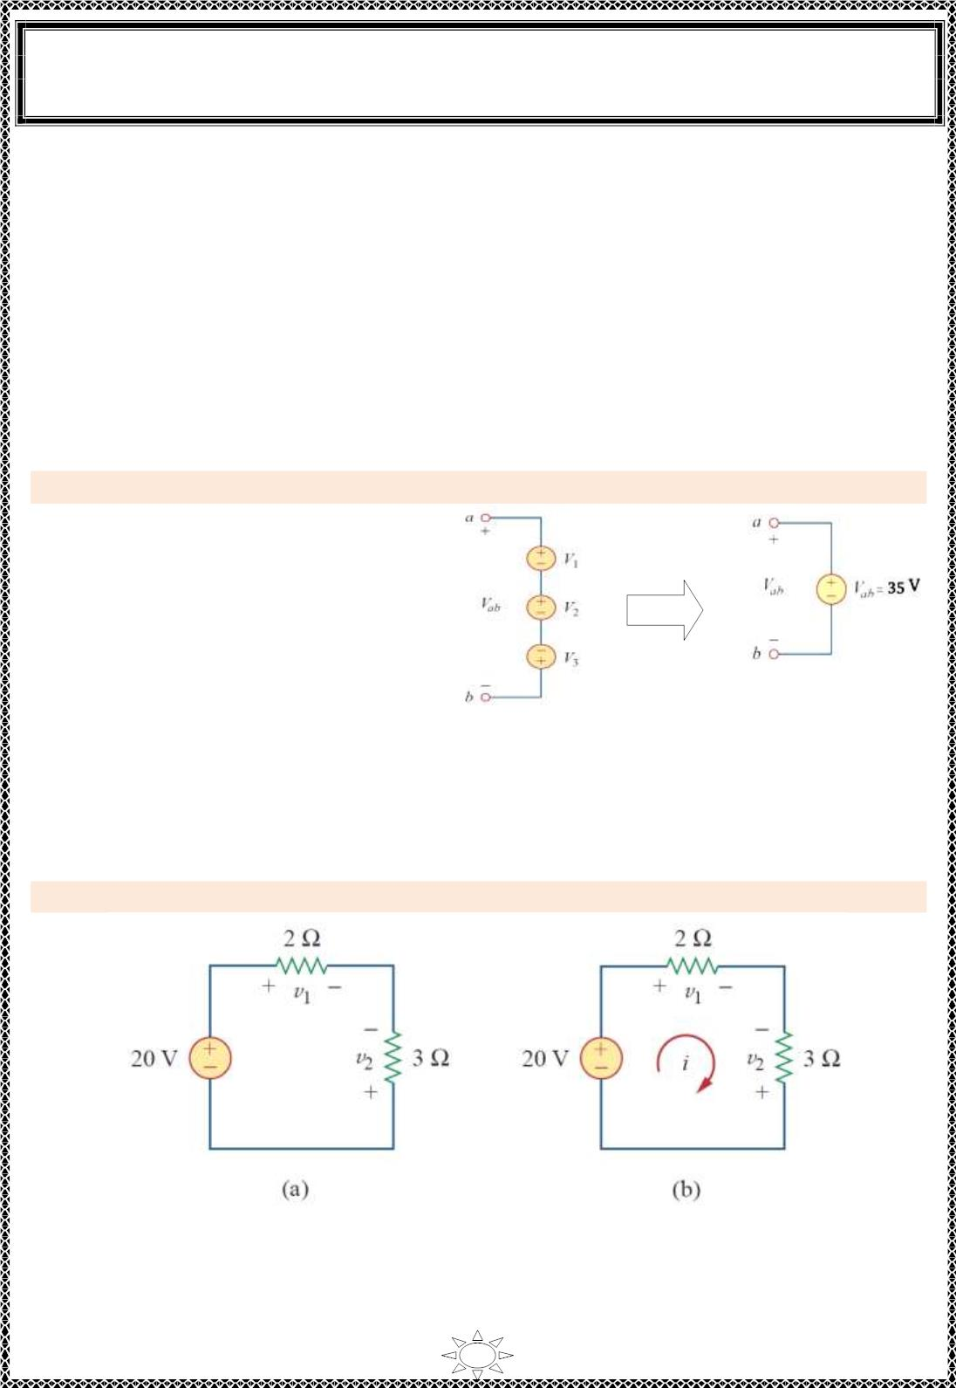
University of Diyala
Engineering College
Electronic Department
Electrical Engineering Fundamentals
1st Class
Asst., Lecturer : Wisam N. AL-Obaidi
Year (2013-2014)
1- For voltage source, if we start the loop from negative terminal to positive terminal,
then the voltage s ho uld be given positive sign. On other hand, If we start the lo op
from posit ive terminal to negative terminal, then the voltage s ho uld be give n
negative sign.
2- For e le me nts (resistances), if we start the loop through the resistor in the same
direct ion as the current through it, then the voltage s ho uld be give n negative sign.
On other hand, if we start the loop through the resistor in the opposite d irection as
the current through it, then the vo ltage s ho uld be given posit ive sign.
Example 1: Find the vo ltage between ter mina ls a & b in Figure (3.3).
Solution:
-V +V +V -V = 0
ab
1
2
3
∴ V = V +V - V
3
ab
1
2
Trail Version
Trail Version
Trail Version
Trail Version
Trail Version
Trail Version
Trail Version
Trail Version
Trail Version
Trail Version
Trail Version
Trail Version
Trail Version
If V = 50 V, V = 30 V & V = 45 V
1
2
3
Then V_{ab} = 50 + 30 – 45 = 35 V
Figure (3.3)
Figure (3.4)
So we can replace the three series sources by a s ing le source equal to (35 V).
Example 2: for the c irc uit in Figure (3.5)(a), find voltages v & v .
1
2
Figure (3 .5)
45

Slide 6
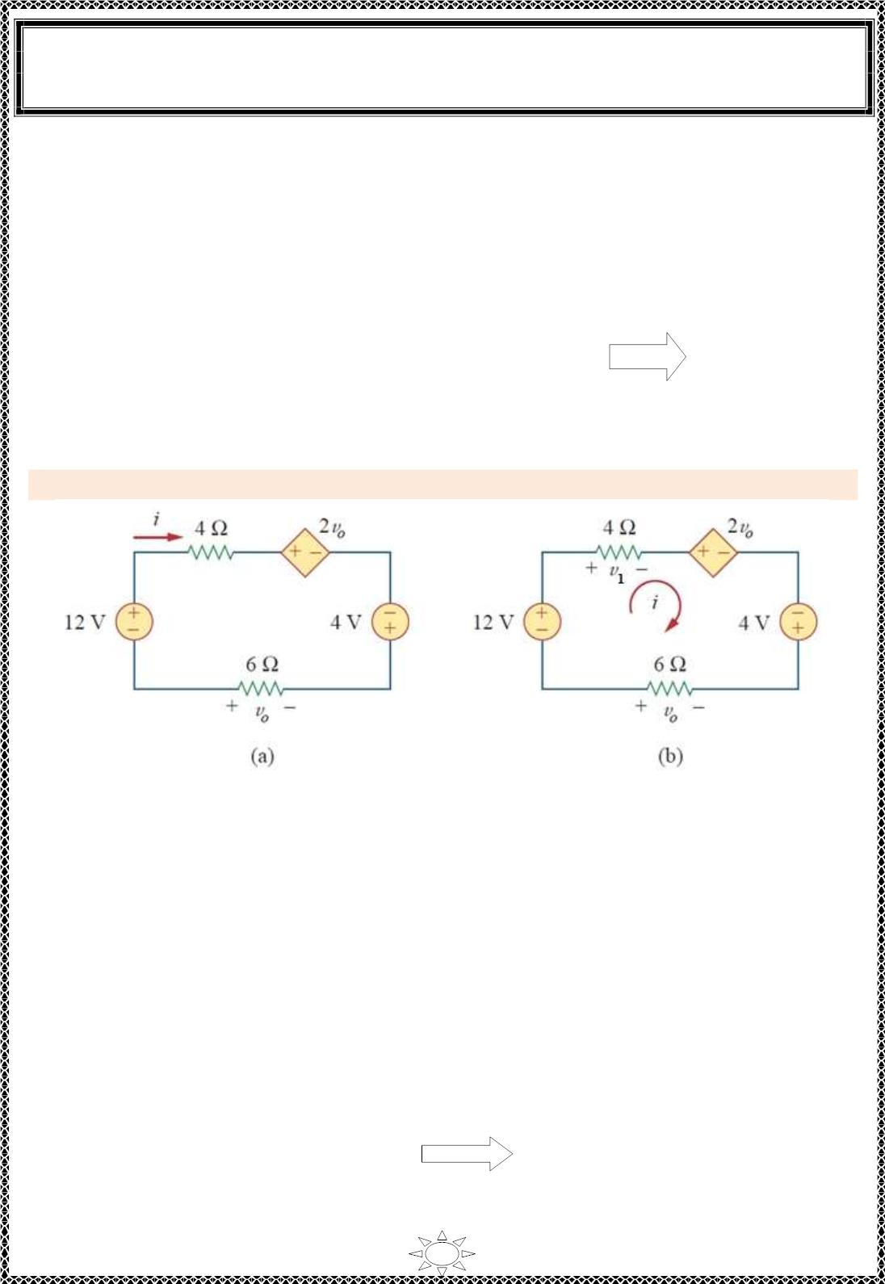
University of Diyala
Engineering College
Electronic Department
Electrical Engineering Fundamentals
1st Class
Asst., Lecturer : Wisam N. AL-Obaidi
Year (2013-2014)
Solution:
To find and we apply Ohm‘s law and Kirchhoff‘s voltage la w.
Assume that current i f lows through the loop as s hown in Figure (3.5)(b).
From Ohm‘s law,
v₂ = −3i
v₁ = 2i,
Applying KVL around the loop gives
−20 + v − v =0
…(1)
…(2)
1
2
Substituting Eq. (1) into Eq. (2), we obtain
−20 + 2i + 3i = 0
or
5i = 20
i = 4 A
Substituting i in Eq. (1) finally gives ,
v₂ = −12 V
v₁ = 8 V,
Example 3: Determine v_{o} and i in the c ircuit shown in Figure (3.6)(a).
Trail Version
Trail Version
Trail Version
Trail Version
Trail Version
Trail Version
Trail Version
Trail Version
Trail Version
Trail Version
Trail Version
Trail Version
Trail Version
Figure (3 .6)
Solution:
We apply KVL around the loop as shown in Figure (3.6)(b). The result is
-12 +v +2v – 4 – v = 0, where v = 4i, v = – 6i
1
o
o
1
o
∴
−12 + 4i + 2v_{o} − 4 + 6i = 0
…(1)
Applying Ohm‘s law to the 6- resistor gives
v_{o} =−6i
…(2)
Substituting Eq. (2) into Eq. (1) yields
−16 +10i − 12i = 0
i =−8 A
and
v_{o} = 48 V.
46

Slide 7
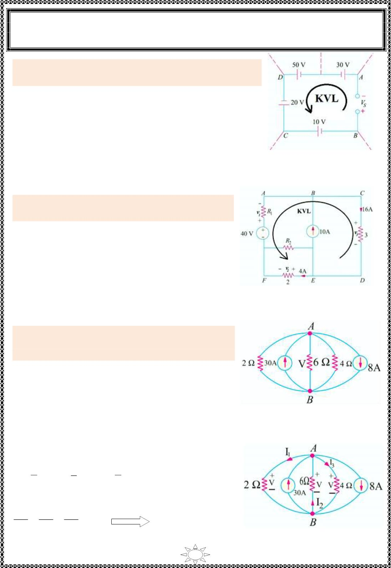
University of Diyala
Engineering College
Electronic Department
Electrical Engineering Fundamentals
1st Class
Asst., Lecturer : Wisam N. AL-Obaidi
Year (2013-2014)
Example 4: What is the vo ltage V_{s} across the open s witc h in
the circuit shown in Figure (3.7), use Kirchhoff‘s laws .
Solution:
Apply KVL starting from point A (counter clock wis e
direc t ion),
+V + 10 − 20 − 50 + 30 = 0
s
∴ V = 30 V
s
Figure (3.7)
Example 5: Find the unknown vo ltage V₁ in the
circuit of Fig ure (3.8), use Kirchhoff‘s laws .
Solution:
Apply KVL through loop ABCDEFA,
–v + 40 – v – v = 0
1
2
3
Trail Version
Trail Version
Trail Version
Trail Version
Trail Version
Trail Version
Trail Version
Trail Version
Trail Version
Trail Version
Trail Version
Trail Version
Trail Version
v = 2i = 2 × 4 = 8 V
2
2
v = 3i = 3 × 16 = 48 V
∴ –v + 40 – 8 – 48 = 0
∴ v = – 16 V
3
1
3
1
Figure (3.8)
Example 6: Us ing Kirchhoff‘s Current Law and
Ohm‘s Law, find the magnitude and polar ity of
voltage V in Figure (3.9).
Solution:
❖ Let us arbitrarily choose the directions of I₁, I₂
and I₃ and polar ity of V as shown in Figure
(3.10).
❖ Applying KCL to node A, we have
Figure (3.9)
−I + 30 + I −I − 8 = 0
Or
I −I + I = 22
1 2 3
1
2
3
Applying Ohm‘s law to the three resist ive branches in
Figure (3.10), we have
푉
푉
6
푉
I = , I = − and I =
1
2
2
3
4
Substituting these values in ( i) above, we get
푉
+
푉
+
푉
= 22
∴ V = 24 V
2
6
4
∴ I = V/2 = 24/2 = 12 A, I = − 24/6 = − 4 A, I = 24/4 = 6 A
Figure (3.10)
1
2
3
47

Slide 8
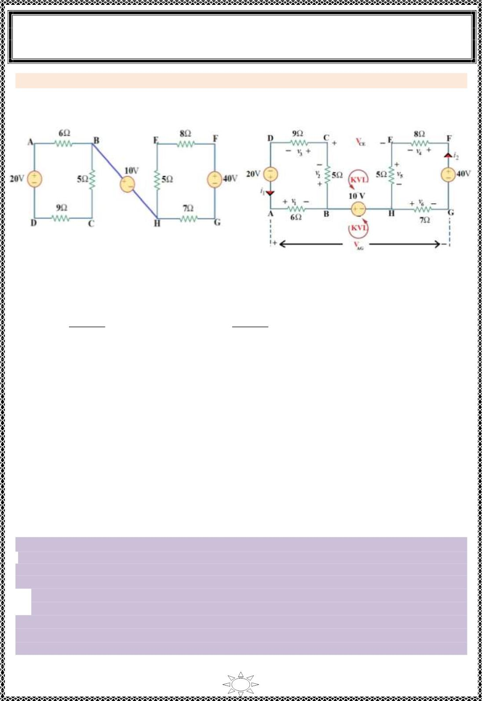
University of Diyala
Engineering College
Electronic Department
Electrical Engineering Fundamentals
1st Class
Asst., Lecturer : Wisam N. AL-Obaidi
Year (2013-2014)
Example 7: For the c irc uit in Figure (3.11) find V & V us ing Kirchhoff‘s laws.
Solution:
CE
AG
Redraw the circuit as shown in Figure (3.12).
Figure (3.11)
Figure (3.12)
❖ To find VCB & VBH, we must find i & i .
20
1
2
40
Trail Version
Trail Version
Trail Version
Trail Version
Trail Version
Trail Version
Trail Version
Trail Version
Trail Version
Trail Version
Trail Version
Trail Version
Trail Version
i₁ =
6+5+9
= 1 A
&
i₂ =
8+5+7
= 2 A
❖ To find V_{CE} , apply KVL for loop EC BHE as shown in Figure (3.12).
– V – v + 10 – v = 0
CE
2
5
V = –v + 10 – v
CE
2
5
v = 5 i = 5 × 1 = 5V
&
v = 5 i = 5 × 2 = 10V
5 2
2
1
∴V = – 5 + 10 – 10 = – 5 V
CE
❖ To find V_{AG}, apply KVL on loop ABHGA shown in Figure (3.12).
– V + v + 10 + v = 0
AG
1
6
V
= v + 10 + v
AG
1 6
v = 6 i = 6 × 1 = 6V
&
v = 7 i = 7 × 2 = 14V
6 2
1
1
∴ V = 6 + 10 + 14 = 30 V
AG
Note:
❖ V_{CE} = V_{CB} + V_{BH} + V_{HE}
Or V_{CE} = V_{CD} + V_{DA} + V_{AB} + V_{BH} + V_{HE}
❖ V_{CB} = –v₂ = – 5i₁
V_{HE} = –v₅ = – 5i₂
Or
V_{CE} = V_{CB} + V_{BH} + V_{HG} + V_{GF} + V_{FE}
Or V = V + V_{DA} + V_{AB} + V_{BH} + V_{HG} + V_{GF} + V_{FE}
CE
CD
V_{BH} = 10
❖ V_{CB} + V_{BH} + V_{HE} = (V – V ) + (V – V ) + (V – V ) = V – V = V
CE
C
B
B
H
H
E
C
E
❖ V_{AG} = V_{AB} + V_{BH} + V_{HG} = (V – V ) + (V – V ) + (V – V ) = V – V = V
A
B
B
H
H
G
A
G
AG
48

Slide 9
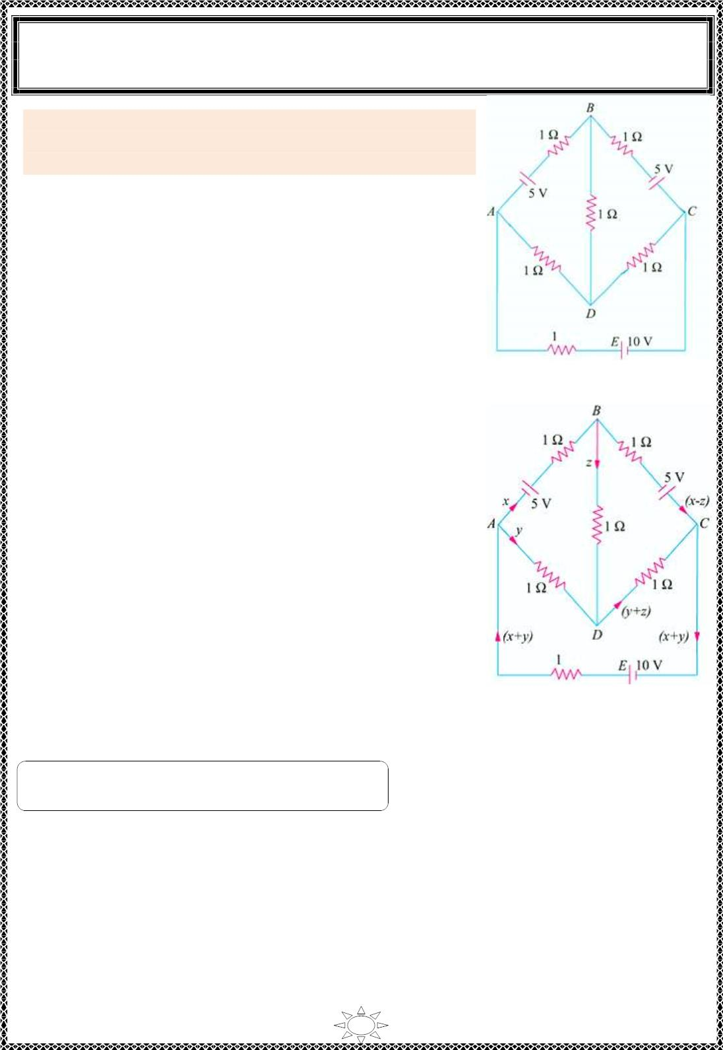
University of Diyala
Engineering College
Electronic Department
Electrical Engineering Fundamentals
1st Class
Asst., Lecturer : Wisam N. AL-Obaidi
Year (2013-2014)
Example 8: Determine the branch currents in the network
of Figure (3.13) when the va lue of each branch resistance
is one ohm, using Kirchhoff‘s laws.
Solution:
Indicate the currents direct ion in the network branches as
shown in Figure (3.14).
Apply Kirchhoff‘s Seco nd law to the closed c irc uit ABDA,
we get
5 −x −z + y = 0
Similarly, circuit BCDB gives
− (x −z) + 5 + (y + z) + z= 0 or
Lastly, from circuit ADCEA, we get
−y − (y + z) + 10 − (x + y) = 0 or
From Eq. (i) and (ii), we get, z = 0
or
x −y + z = 5 ...(i)
x −y − 3z = 5 ...(ii)
x + 3y + z = 10 ...(iii)
Figure (3 .13)
Substituting z = 0 e ithe r in Eq.(i) or (ii) & in Eq.(iii), we get
x −y = 5
x + 3y = 10
...(iv)
...(v)
Trail Version
Trail Version
Trail Version
Trail Version
Trail Version
Trail Version
Trail Version
Trail Version
Trail Version
Trail Version
Trail Version
Trail Version
Trail Version
Subtracting Eq. (v) from (iv), we get
− 4y = − 5
Eq. (iv) gives
or
y = 5/4 = 1.24 A
x = 25/4 A = 6.25 A
Current in branch AB = current in branch BC = 6.25 A
Current in branch BD = 0
current in branch AD = current in branch DC = 1.25 A
current in branch CEA = 6.25 + 1.25 = 7.5 A.
Fig ure (3.14)
H.W.: For Example 7, find the p.d. ac ros s AC.
49

Slide 10
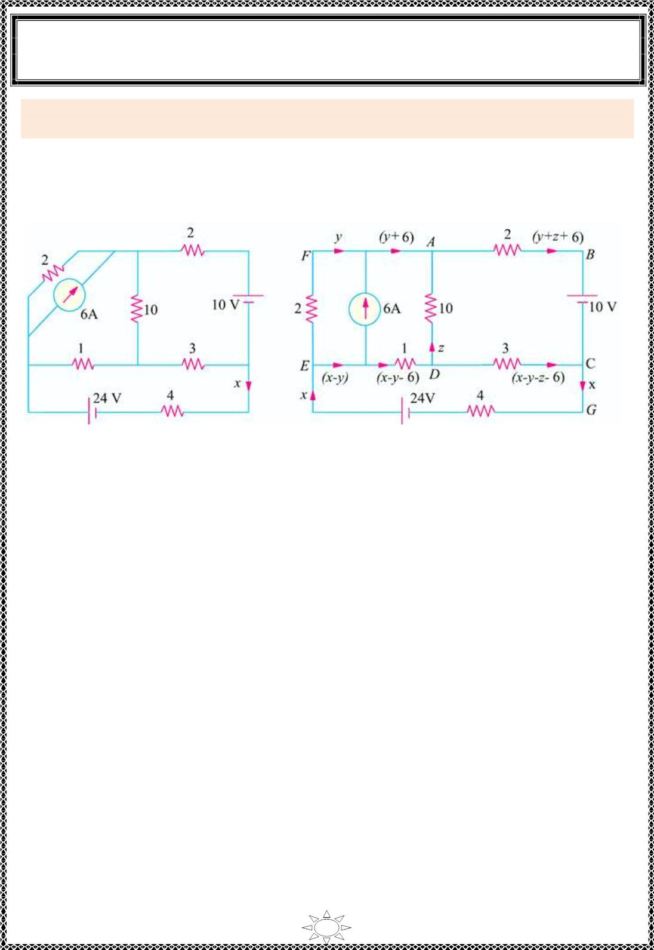
University of Diyala
Engineering College
Electronic Department
Electrical Engineering Fundamentals
1st Class
Asst., Lecturer : Wisam N. AL-Obaidi
Year (2013-2014)
Example 9: Determine the current x in the 4-Ω res istance of the c irc uit shown in Figure
(3.15), using Kirchhoff‘s laws.
Solution:
The given circuit is redrawn with assumed dis tribut ion of currents in Figure (3.16).
Applying KVL to different closed lo ops , we get
Figure (3 .15)
Figure (3.16)
Trail Version
Trail Version
Trail Version
Trail Version
Trail Version
Trail Version
Trail Version
Trail Version
Trail Version
Trail Version
Trail Version
Trail Version
Trail Version
Circuit EFADE
− 2y + 10z + (x −y − 6) = 0
x − 3y + 10z = 6
or
...(i)
...(ii)
...(iii)
Circuit ABCDA
2 (y + z + 6) − 10 + 3 (x −y −z − 6) − 10z = 0
3x − 5y − 14z = 40
Circuit EDCGE
− (x −y − 6) − 3(x −y −z − 6) − 4x + 24 = 0
8x − 4y − 3z = 48
From above equations we get x = 4.1 A
or
or
50

